Slide 1
Text Classification

Slide 2
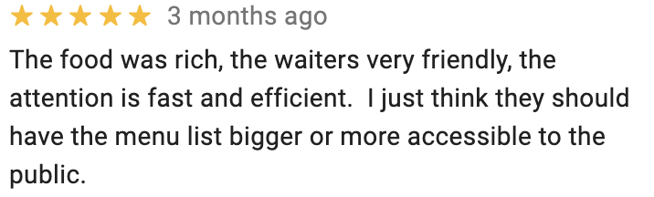


Sentiment Analysis

Slide 3


Sentiment Analysis
“This movie was amazing”
“I’ve seen it 8 times!”
“I fell asleep”
“I wouldn’t recommend it”

Slide 4
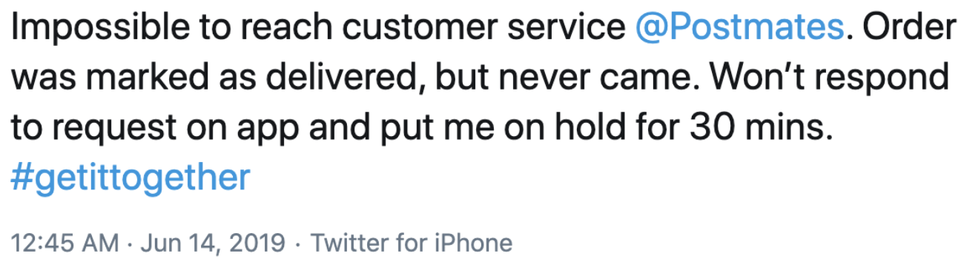

Why Care about Sentiment?
Insights about brand, products, features, changes over time, etc.
Investors trying to understand markets

Slide 5

IMDB Review Dataset
50000 user-written movie reviews
No more than 30 reviews per movie
Only highly polarized reviews
positive: 7 or higher
negative: 4 or lower
Balanced labels
Train split: 25000; Test split: 25000
Internet Movie Database
[source]
“This is the kind of film for a snowy Sunday afternoon when the rest of the world can go ahead with its own business as you descend into a big arm-chair and mellow for a couple of hours. Wonderful performances from Cher and Nicolas Cage (as always) gently row the plot along. There are no rapids to cross, no dangerous waters, just a warm and witty paddle through New York life at its best. A family film in every sense and one that deserves the praise it received.”

Slide 6
Vocabulary
“This movie was amazing”
“I’ve seen it 8 times!”
“I fell asleep”
“I wouldn’t recommend it”

Slide 7
Vocabulary
0
1
2
3
4
5
6
7
8
9
10
11
12
13
14
15
!
8
amazing
asleep
fell
movie
i
i’ve
it
recommend
seen
this
times
was
wouldn’t
“This movie was amazing”
“I’ve seen it 8 times!”
“I fell asleep”
“I wouldn’t recommend it”

Slide 8
Vocabulary
0
1
2
3
4
5
6
7
8
9
10
11
12
13
14
15
!
8
amazing
asleep
fell
movie
i
i’ve
it
recommend
seen
this
times
was
wouldn’t
“This movie was amazing”
“I’ve seen it 8 times!”
“I fell asleep”
“I wouldn’t recommend it”
[12, 6, 14, 3]
[8, 11, 9, 2, 13, 1]
[7, 5, 4]
[7, 15, 10, 9]

Slide 9
Vocabulary
0
1
2
3
4
5
6
7
8
9
10
11
12
13
14
15
OOV
!
8
amazing
asleep
fell
movie
i
i’ve
it
recommend
seen
this
times
was
wouldn’t
“This movie was amazing”
“I’ve seen it 8 times!”
“I fell asleep”
“I wouldn’t recommend it”
“This movie was terrific”
“glorf niz curp”
[12, 6, 14, 3]
[8, 11, 9, 2, 13, 1]
[7, 5, 4]
[7, 15, 10, 9]
[12, 6, 14, 0]
[0, 0, 0]

Slide 10
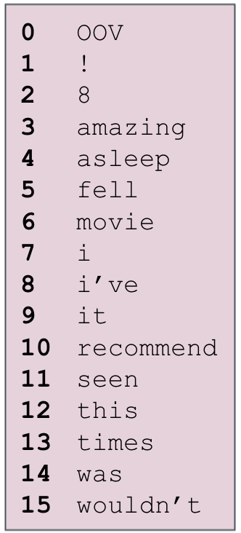
Working with Text
“This movie was amazing”
“I’ve seen it 8 times!”
“I fell asleep”
“I wouldn’t recommend it”
[12, 6, 14, 3]
[8, 11, 9, 2, 13, 1]
[7, 5, 4]
[7, 15, 10, 9]
What are the basic units?
Which features are included in the vocabulary?
Each input is sparse (most features not present)
Variable-length inputs

Slide 11
Text Classification
Notes:
Q: [True/False] The Vocabulary always includes all words appearing in the training set.
A: False

Slide 12
Bag of Words

Slide 13
One-Hot Encoding
0 0 0 0
0 0 0 0
0 0 0 0
0 0 0 1
0 0 0 0
0 0 0 0
0 1 0 0
0 0 0 0
0 0 0 0
0 0 0 0
0 0 0 0
0 0 0 0
1 0 0 0
0 0 0 0
0 0 1 0
0 0 0 0
“This movie was amazing”
[12, 6, 14, 3]

Slide 14
One-Hot Encoding
0 0 0 0
0 0 0 0
0 0 0 0
0 0 0 0
0 0 1 0
0 1 0 0
0 0 0 0
1 0 0 0
0 0 0 0
0 0 0 0
0 0 0 0
0 0 0 0
0 0 0 0
0 0 0 0
0 0 0 0
0 0 0 0
“This movie was amazing”
“I fell asleep”
[12, 6, 14, 3]
[7, 5, 4]

Slide 15
Bag of Words Encoding
0 0 0 0
0 0 0 0
0 0 0 0
0 0 0 1
0 0 0 0
0 0 0 0
0 1 0 0
0 0 0 0
0 0 0 0
0 0 0 0
0 0 0 0
0 0 0 0
1 0 0 0
0 0 0 0
0 0 1 0
0 0 0 0
0
0
0
1
0
0
1
0
0
0
0
0
1
0
1
0
Sum one-hot encodings
Keep identity of included words
Throws out word order
“this movie was amazing”
“was this movie amazing”

Slide 16
Logistic Regression Classifier
0
0
0
1
0
0
1
0
0
0
0
0
1
0
1
0

Slide 17
Feed Forward NN Classifier
0
0
0
1
0
0
1
0
0
0
0
0
1
0
1
0

Slide 18
Tokenization
What are the basic units?
words
characters
bytes

Slide 19
Tokenization
What are the basic units?
words
characters
bytes
“I’ve seen it 8 times!”
Sample tokenizer rules:
I’ve -> I have
8 -> [NUM]
times! -> times !
lowercasing
“i have seen it [NUM] times !”

Slide 20
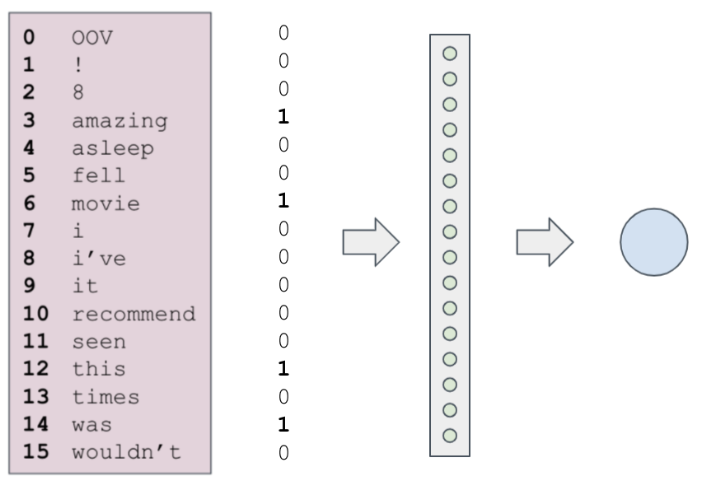
Vocabulary Selection
Which features are included in the vocabulary?
Typically, the most frequent tokens in the training data
A large model could have 1M tokens
You’ll use vocabulary sizes in [1000, 100000] for IMDB

Slide 21
Bag of Words
Notes:
Q: [True/False] The Bag-of-Words assumption is that word order does not matter.
A: True

Slide 22
Contextual Encodings

Slide 23
One-Hot Encoding
“This movie was amazing”
0 0 0 0
0 0 0 0
0 0 0 0
0 0 0 1
0 0 0 0
0 0 0 0
0 1 0 0
0 0 0 0
0 0 0 0
0 0 0 0
0 0 0 0
0 0 0 0
1 0 0 0
0 0 0 0
0 0 1 0
0 0 0 0
Do these one-hot vectors capture any word meanings?
Any similarity between words?

Slide 24
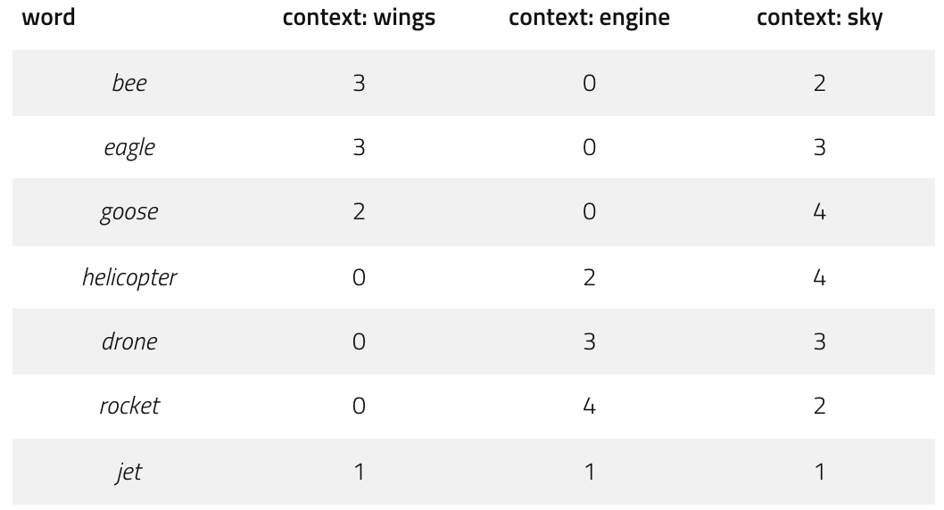
Meaning from Context
“You shall know a word by the company it keeps”
– John Firth (1957)

Slide 25
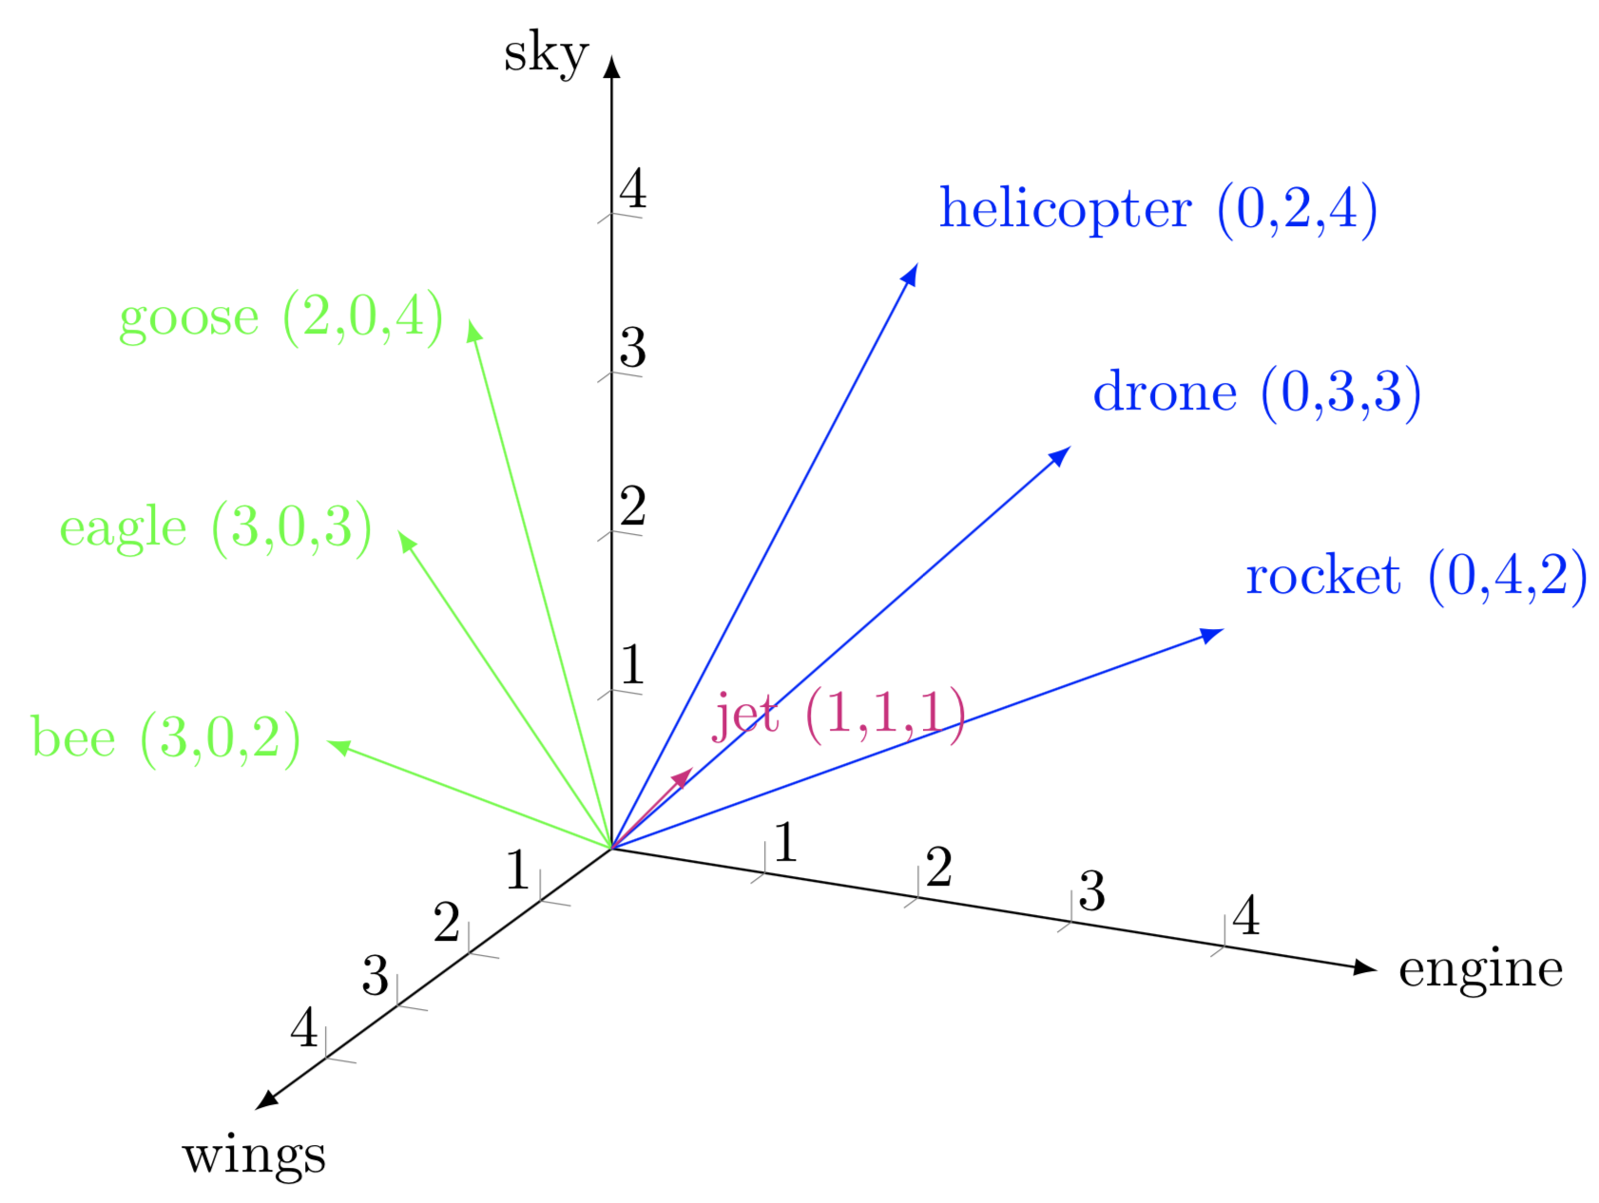
Contextual Encoding
[source]

Slide 26
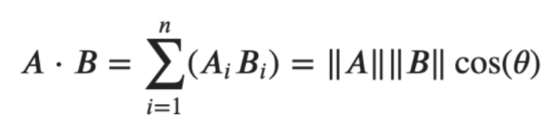
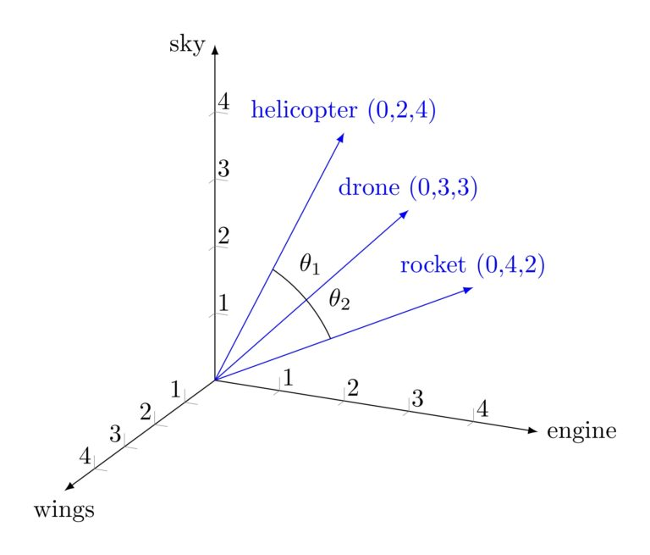
Word Similarities
Notes:
cos sim = np.dot(x,y) / (np.linalg.norm(x) * np.linalg.norm(y))
f=lambda x,y: np.arccos(np.dot(x,y) / (np.linalg.norm(x) * np.linalg.norm(y))) * (180/np.pi)
f(helicopter, drone) = 18
f(helicopter, rocket) = 36

Slide 27
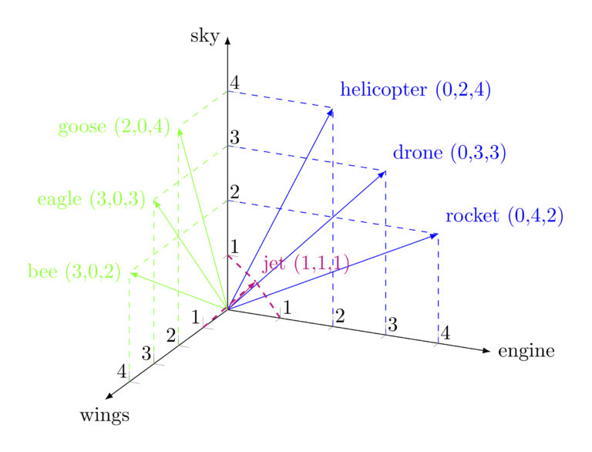
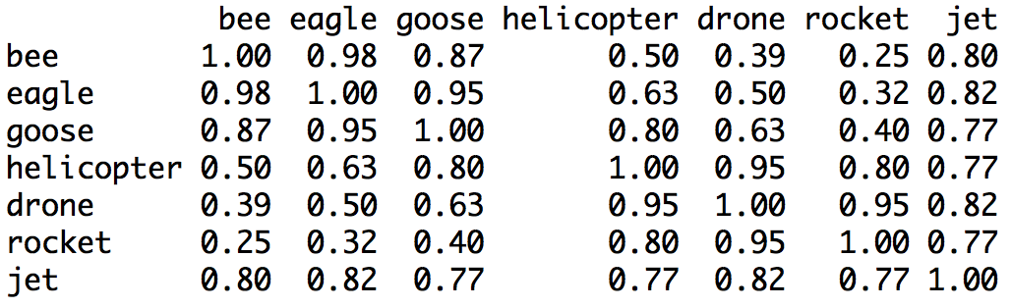
Word Similarities
Notes:
cosine similarities

Slide 28
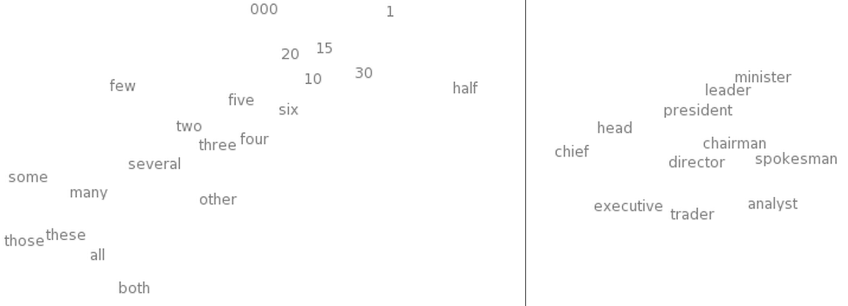
Embeddings
An embedding is a learned contextual encoding
t-SNE visualizations of word embeddings. From Turian et al. (2010)
Notes:
one-hot encodings -> embeddings turns out to be a powerful innovation

Slide 29
Contextual Encodings
Notes:
Q: [True/False] One-hot encoding of words does not capture any information about relationships between words.
A: True

Slide 30
Bag of Embeddings

Slide 31
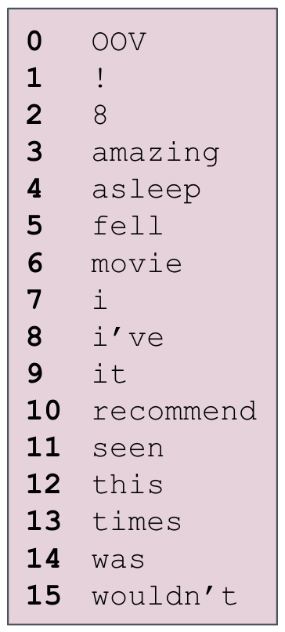
Embeddings are Parameters
“This movie was amazing”
12 6 14 3
0 0 0 0
0 0 0 0
0 0 0 0
0 0 0 1
0 0 0 0
0 0 0 0
0 1 0 0
0 0 0 0
0 0 0 0
0 0 0 0
0 0 0 0
0 0 0 0
1 0 0 0
0 0 0 0
0 0 1 0
0 0 0 0

Slide 32
Embeddings are Parameters
“This movie was amazing”
“This movie was amazing”
12 6 14 3
12 6 14 3
0 0 0 0
0 0 0 0
0 0 0 0
0 0 0 1
0 0 0 0
0 0 0 0
0 1 0 0
0 0 0 0
0 0 0 0
0 0 0 0
0 0 0 0
0 0 0 0
1 0 0 0
0 0 0 0
0 0 1 0
0 0 0 0
1 4 1 2
2 0 1 4
2 1 2 4
3 1 1 3
2 3 1 1

Slide 33
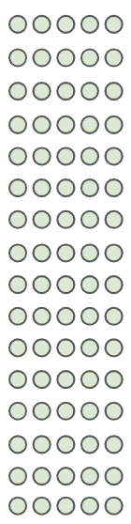

Bag of Embeddings Model
“This movie was amazing”

Slide 34
Bag of Embeddings Model
“This movie was amazing”
Vectorize
Layer
Embedding
Layer
Average
Pooling
Layer
Dense
Layer
Output
Layer
(sigmoid)

Slide 35
Bag of Embeddings Model
68, 60, 20
59, 63, 14
75, 16, 42
0, 0, 0
0, 0, 0
0, 0, 0
0, 0, 0
Vectorize
Layer
Embedding
Layer
“I fell asleep”
[8, 6, 5, 0, 0, 0, 0]
Average
Pooling
Layer
Output
Layer
(sigmoid)
[28.85, 19.85, 20.85]
0.42

Slide 36
Bag of Embeddings
Notes:
Q: If we have a vocabulary with 1000 tokens and our embedding dimension is 32, how many embedding parameters are in our model?
A: 32000

Slide 37
Learning Embeddings

Slide 38
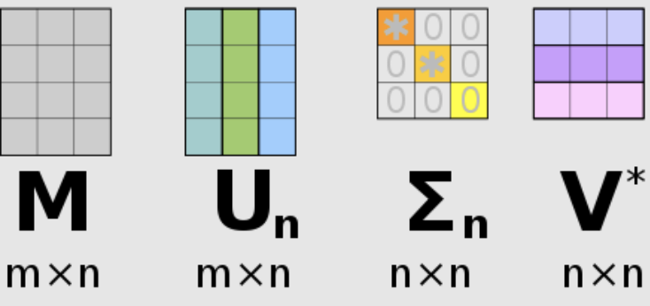
Embeddings via SVD
Notes:
bee, eagle, goose, helicopter, drone, rocket, jet

Slide 39
Embeddings via SVD
Notes:
bee, eagle, goose, helicopter, drone, rocket, jet

Slide 40
Language Modeling
Predict the next word:
How to poach ________
chicken
eggs
how
poach
to
Vocabulary

Slide 41
Language Modeling
Averaged embeddings
Embedding Lookup
Input
how
to
poach

Slide 42
Language Modeling
chicken
eggs
Softmax to predict the next word
how
poach
to
Softmax Parameters
Averaged embeddings
chicken
Embedding Lookup
eggs
how
poach
to
Input
how
to
poach
Embeddings
Parameters

Slide 43

Language Modeling
chicken
eggs
Softmax to predict the next word
how
poach
to
Softmax Parameters
Averaged embeddings
chicken
Embedding Lookup
eggs
how
poach
to
Input
how
to
poach
???
Embeddings
Parameters

Slide 44
Language Modeling
Cross Entropy
chicken
eggs
how
poach
to
Softmax Parameters
chicken
eggs
how
poach
to
Embeddings
Parameters
how
to
poach
eggs

Slide 45
Language Modeling
Cross Entropy
chicken
eggs
how
poach
to
Softmax Parameters
chicken
eggs
how
poach
to
Embeddings
Parameters
how
to
poach
eggs

Slide 46
Aside: Sampled Softmax
chicken
Our LM has 1M output classes. Is that a problem?
Takes a lot of memory
And a lot of computation
eggs
how
poach
to
Softmax Parameters

Slide 47
Aside: Sampled Softmax
chicken
Our LM has 1M output classes. Is that a problem?
Takes a lot of memory
And a lot of computation
Instead, just choose a few classes as competitors
This is called sampled softmax
Much faster!
eggs
how
poach
to
Softmax Parameters

Slide 48
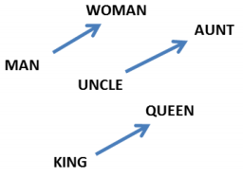
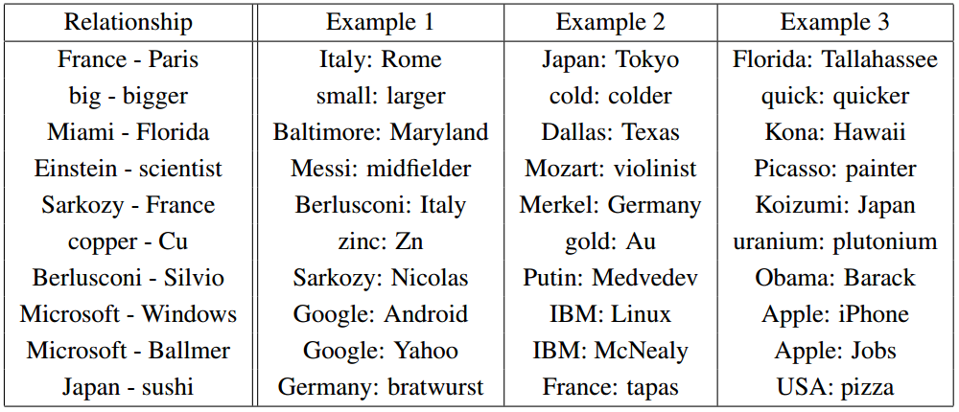
Learned Embeddings
From Mikolov et al. (2013a)
Trained on large text datasets
Embedding dimension ~[100, 1000]
Embeddings contain lots of information
From Mikolov et al. (2013b)
Notes:
The relationships between embeddings is a by-product of the training procedure

Slide 49
Distributed Representation
Could the model learn a one-hot representation of the words?
What do the embeddings at each position represent?
What happens when a word has more than one meaning?

Slide 50
Learning Embeddings
Notes:
Q: [True/False] Learned embeddings encode many complex relationships in a shared vector space.
A: True

Slide 51
Why Embeddings?

Slide 52
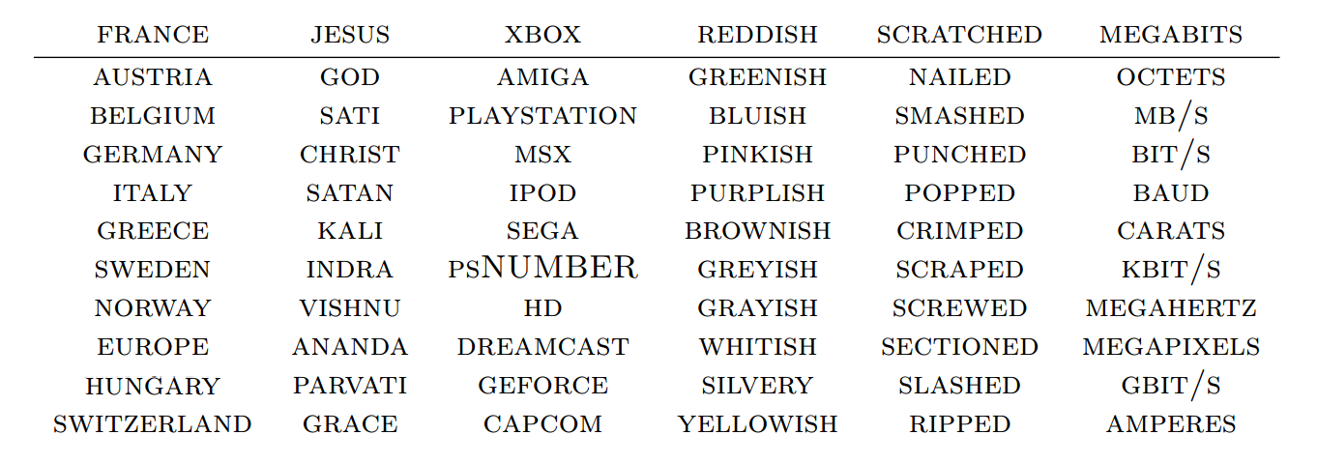
Generalization Power
Our model still needs to see examples of all words
But it can generalize to new combinations of words
What words have embeddings closest to a given word? From Collobert et al. (2011)
Notes:
this movie was amazing ->
this movie was great
this movie was terrible

Slide 53
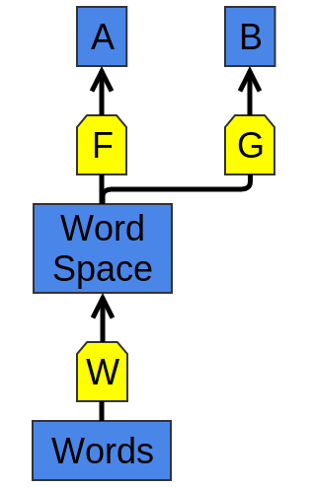
Transfer Learning
First, train a model F(W(x)) on task A, with a set of word embeddings as a byproduct
Then, train a model G(W(x)) on task B, reusing the embeddings W(x)
The data for task B can be very small relative to task A
[source]

Slide 54
Transfer Learning
Logistic Regression to predict label
positive
negative
Averaged embeddings
Embedding Lookup
Input
didn’t
like
it
10M words
IMDB Reviews
Notes:
This is G(W(x))

Slide 55
Transfer Learning
Logistic Regression to predict label
positive
negative
Averaged embeddings
Embedding Lookup
Embeddings
Parameters
from LM
Input
didn’t
like
it
3.5B words
Wikipedia Text
10M words
IMDB Reviews
Notes:
Import W(x)

Slide 56
Transfer Learning
Token Count
-----------------
good 15743
interesting 3175
mediocre 366
mercurial 6
undulating 1
salubrious 1
topsy-turvy 0
Token Count
-----------------
good 1M
interesting 100k
mediocre 22k
mercurial 3k
undulating 290
salubrious 121
topsy-turvy 1375
3.5B words
Wikipedia Text
10M words
IMDB Reviews

Slide 57
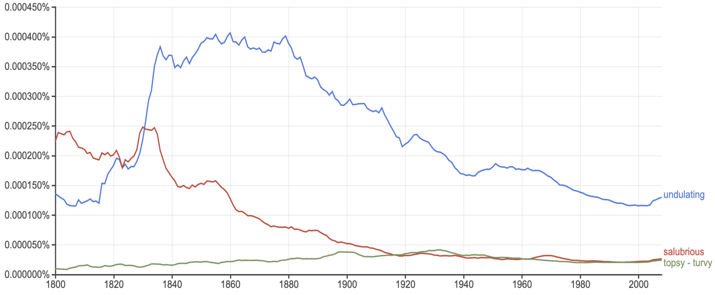
Topsy-Turvy

Slide 58
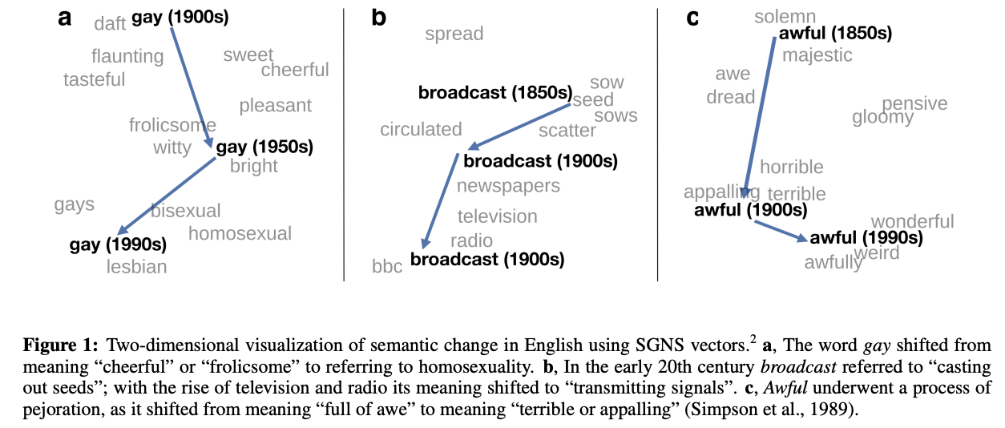
Tracking Meaning over Time
[source]

Slide 59
Why Embeddings?
Notes:
Q: [True/False] Transfer learning assumes that the new task is the same as the original task.
A: False

